Slide 1


CSE3078 – Cryptography and Network Security
School of Computer Science and Engineering

Slide 2
Module 4
Network Security

Slide 3
User Authentication
will consider authentication functions
developed to support application-level authentication & digital signatures
will consider Kerberos – a private-key authentication service
then X.509 directory authentication service

Slide 4
Kerberos
trusted key server system from MIT
provides centralised private-key third-party authentication in a distributed network
allows users access to services distributed through network
without needing to trust all workstations
rather all trust a central authentication server
two versions in use: 4 & 5

Slide 5
Kerberos Requirements
first published report identified its requirements as:
security
reliability
transparency
scalability
implemented using an authentication protocol based on Needham-Schroeder

Slide 6
Kerberos 4 Overview
a basic third-party authentication scheme
have an Authentication Server (AS)
users initially negotiate with AS to identify self
AS provides a non-corruptible authentication credential (ticket granting ticket TGT)
have a Ticket Granting server (TGS)
users subsequently request access to other services from TGS on basis of users TGT

Slide 7
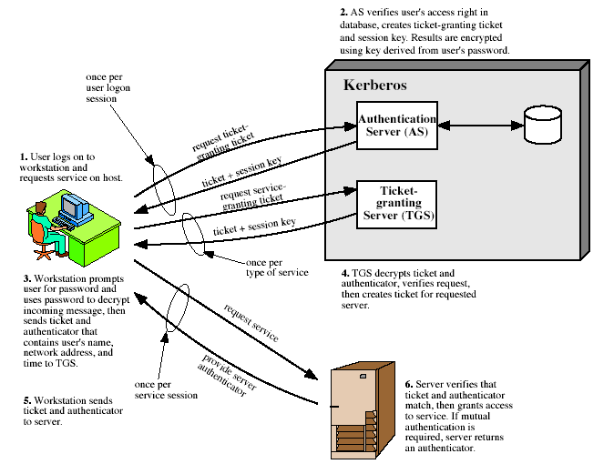
Kerberos 4 Overview

Slide 8
Kerberos Version 5
developed in mid 1990’s
provides improvements over v4
addresses environmental shortcomings
encryption alg, network protocol, byte order, ticket lifetime, authentication forwarding, interrealm auth
and technical deficiencies
double encryption, non-std mode of use, session keys, password attacks
specified as Internet standard RFC 1510

Slide 9
IP Security
have considered some application specific security mechanisms
eg. S/MIME, PGP, Kerberos, SSL/HTTPS
however there are security concerns that cut across protocol layers
would like security implemented by the network for all applications

Slide 10
IPSec
general IP Security mechanisms
provides
authentication
confidentiality
key management
applicable to use over LANs, across public & private WANs, & for the Internet

Slide 11
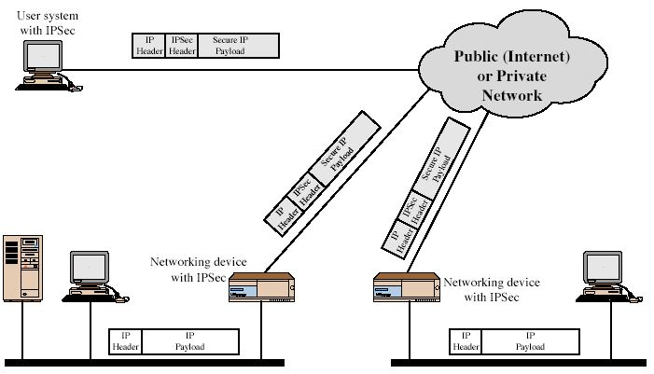
IPSec Uses
Notes:
Stallings Fig 16-1.

Slide 12
Benefits of IPSec
in a firewall/router provides strong security to all traffic crossing the perimeter
is resistant to bypass
is below transport layer, hence transparent to applications
can be transparent to end users
can provide security for individual users if desired

Slide 13
IP Security Architecture
specification is quite complex
defined in numerous RFC’s
incl. RFC 2401/2402/2406/2408
many others, grouped by category
mandatory in IPv6, optional in IPv4

Slide 14
IPSec Services
Access control
Connectionless integrity
Data origin authentication
Rejection of replayed packets
a form of partial sequence integrity
Confidentiality (encryption)
Limited traffic flow confidentiality

Slide 15
Authentication Header (AH)
provides support for data integrity & authentication of IP packets
end system/router can authenticate user/app
prevents address spoofing attacks by tracking sequence numbers
based on use of a MAC
HMAC-MD5-96 or HMAC-SHA-1-96
parties must share a secret key

Slide 16
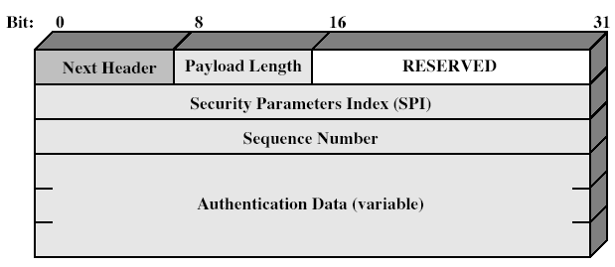
Authentication Header
Notes:
Stallings Fig 16-3.

Slide 17
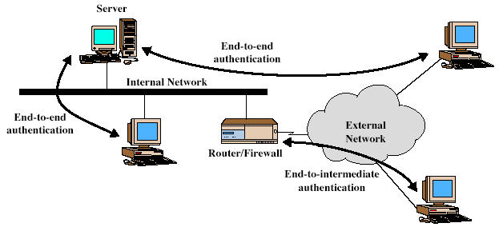
Transport & Tunnel Modes
Notes:
Stallings Fig 16-5.

Slide 18
Encapsulating Security Payload (ESP)
provides message content confidentiality & limited traffic flow confidentiality
can optionally provide the same authentication services as AH
supports range of ciphers, modes, padding
incl. DES, Triple-DES, RC5, IDEA, CAST etc
CBC most common
pad to meet blocksize, for traffic flow

Slide 19
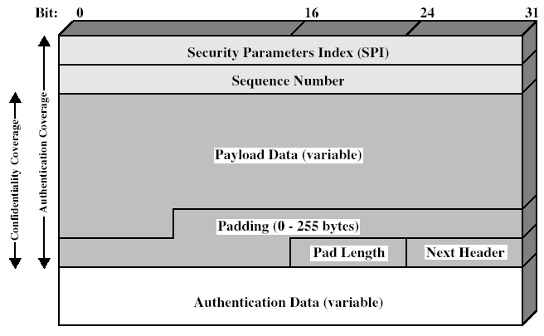
Encapsulating Security Payload
Notes:
Stallings Fig 16-7.

Slide 20
Transport vs Tunnel Mode ESP
transport mode is used to encrypt & optionally authenticate IP data
data protected but header left in clear
can do traffic analysis but is efficient
good for ESP host to host traffic
tunnel mode encrypts entire IP packet
add new header for next hop
good for VPNs, gateway to gateway security

Slide 21
Email Security
email is one of the most widely used and regarded network services
currently message contents are not secure
may be inspected either in transit
or by suitably privileged users on destination system
Notes:
Current email services are roughly like "postcards". Anyone who wants could pick it up and have a look as its in transit or sitting in the recipients mailbox.

Slide 22
Email Security Enhancements
confidentiality
protection from disclosure
authentication
of sender of message
message integrity
protection from modification
non-repudiation of origin
protection from denial by sender
Notes:
What we want is something more akin to standard mail (contents protected inside an envelope) if not registered mail (have confidence about the sender of the mail and its contents).

Slide 23
Pretty Good Privacy (PGP)
widely used de facto secure email
developed by Phil Zimmermann
selected best available crypto algs to use
integrated into a single program
available on Unix, PC, Macintosh and Amiga systems
originally free, now have commercial versions available also

Slide 24
PGP Operation – Authentication
sender creates a message
SHA-1 used to generate 160-bit hash code of message
hash code is encrypted with RSA using the sender's private key, and result is attached to message
receiver uses RSA or DSS with sender's public key to decrypt and recover hash code
receiver generates new hash code for message and compares with decrypted hash code, if match, message is accepted as authentic

Slide 25
PGP Operation – Confidentiality
sender generates message and random 128-bit number to be used as session key for this message only
message is encrypted, using CAST-128 / IDEA/3DES with session key
session key is encrypted using RSA with recipient's public key, then attached to message
receiver uses RSA with its private key to decrypt and recover session key
session key is used to decrypt message

Slide 26
PGP Operation – Confidentiality & Authentication
uses both services on same message
create signature & attach to message
encrypt both message & signature
attach RSA encrypted session key

Slide 27
PGP Operation – Compression
by default PGP compresses message after signing but before encrypting
so can store uncompressed message & signature for later verification
& because compression is non deterministic
uses ZIP compression algorithm

Slide 28
PGP Operation – Email Compatibility
when using PGP will have binary data to send (encrypted message etc)
however email was designed only for text
hence PGP must encode raw binary data into printable ASCII characters
uses radix-64 algorithm
maps 3 bytes to 4 printable chars
also appends a CRC
PGP also segments messages if too big

Slide 29
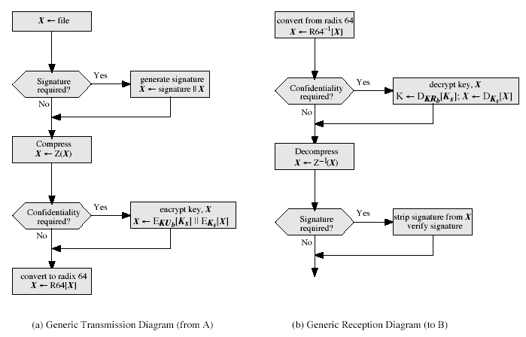
PGP Operation – Summary
Notes:
Stallings Fig 15-2.

Slide 30
PGP Session Keys
need a session key for each message
of varying sizes: 56-bit DES, 128-bit CAST or IDEA (International Data for Encryption Algorithm), and
168-bit Triple-DES
generated using ANSI X12.17 mode
uses random inputs taken from previous uses and from keystroke timing of user

Slide 31
PGP Public & Private Keys
since many public/private keys may be in use, need to identify which is actually used to encrypt session key in a message
could send full public-key with every message
but this is inefficient
rather use a key identifier based on key
is least significant 64-bits of the key
will very likely be unique
also use key ID in signatures

Slide 32
S/MIME (Secure/Multipurpose Internet Mail Extensions)
security enhancement to MIME email
original Internet RFC822 email was text only
MIME provided support for varying content types and multi-part messages
with encoding of binary data to textual form
S/MIME added security enhancements
have S/MIME support in various modern mail agents: MS Outlook, Netscape etc

Slide 33
S/MIME Functions
enveloped data
encrypted content and associated keys
signed data
encoded message + signed digest
clear-signed data
cleartext message + encoded signed digest
signed & enveloped data
nesting of signed & encrypted entities

Slide 34
S/MIME Cryptographic Algorithms
hash functions: SHA-1 & MD5
digital signatures: DSS & RSA
session key encryption: ElGamal & RSA
message encryption: Triple-DES, RC2/40 and others
have a procedure to decide which algorithms to use

Slide 35
Web Security
Web now widely used by business, government, individuals
but Internet & Web are vulnerable
have a variety of threats
integrity
confidentiality
denial of service
authentication
need added security mechanisms

Slide 36
SSL (Secure Socket Layer)
transport layer security service
originally developed by Netscape
version 3 designed with public input
subsequently became Internet standard known as TLS (Transport Layer Security)
uses TCP to provide a reliable end-to-end service
SSL has two layers of protocols
Notes:
SSL probably most widely used Web security mechanism. Its implemented at the Transport layer; cf IPSec at Network layer; or various Application layer mechanisms eg. S/MIME & SET (later).

Slide 37
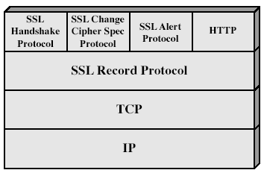
SSL Architecture
Notes:
Stallings Fig 17-2.

Slide 38
SSL Architecture
SSL session
an association between client & server
created by the Handshake Protocol
define a set of cryptographic parameters
may be shared by multiple SSL connections
SSL connection
a transient, peer-to-peer, communications link
associated with 1 SSL session

Slide 39
SSL Record Protocol
confidentiality
using symmetric encryption with a shared secret key defined by Handshake Protocol
IDEA, RC2-40, DES-40, DES, 3DES, Fortezza, RC4-40, RC4-128
message is compressed before encryption
message integrity
using a MAC with shared secret key
similar to HMAC but with different padding
Notes:
SSL Record Protocol defines these two services for SSL connections.

Slide 40
SSL Change Cipher Spec Protocol
one of 3 SSL specific protocols which use the SSL Record protocol
a single message
causes pending state to become current
hence updating the cipher suite in use

Slide 41
SSL Alert Protocol
conveys SSL-related alerts to peer entity
severity
warning or fatal
specific alert
unexpected message, bad record mac, decompression failure, handshake failure, illegal parameter
close notify, no certificate, bad certificate, unsupported certificate, certificate revoked, certificate expired, certificate unknown
compressed & encrypted like all SSL data

Slide 42
SSL Handshake Protocol
allows server & client to:
authenticate each other
to negotiate encryption & MAC algorithms
to negotiate cryptographic keys to be used
comprises a series of messages in phases
Establish Security Capabilities
Server Authentication and Key Exchange
Client Authentication and Key Exchange
Finish

Slide 43
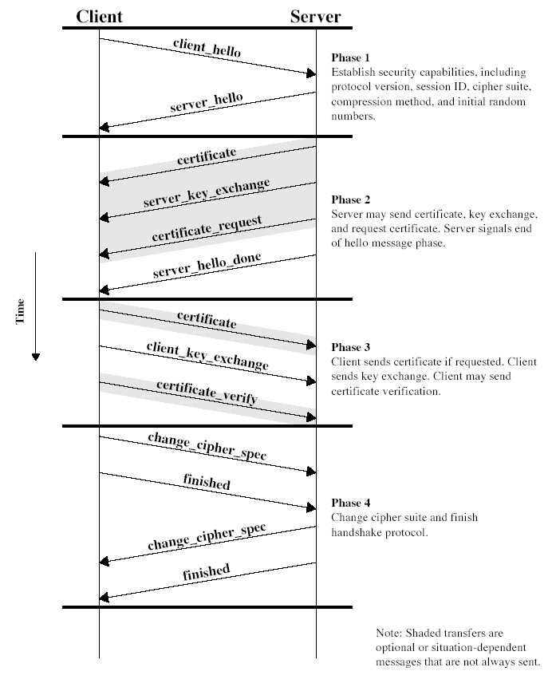
SSL Handshake Protocol
Notes:
Stallings Fig 17-6.

Slide 44


